Slide 1
LISTEN TO THE LAW CLERKS
Presented to the Bankruptcy Bar Association
By Zoom on October 12, 2021
Panelists
Vivian P. Diokno
Kerry Hopkins
Jacob G. Masters
Marios J. Monopolis
Moderator
The Honorable Maria Ellena Chavez-Ruark

Slide 2
CASE ADMINISTRATORS, COURTROOM DEPUTIES,
LAW CLERKS AND
COURT RESOURCES

Slide 3
CASE ADMINISTRATORS
Cases are assigned based on the last two digits of the case number.
The case administrator’s name and telephone number appear at the top of the case docket.
Case administrators are responsible for the dockets for their assigned cases. Their responsibilities include:
    reviewing every pleading filed for completeness;
    making corrective entries on the docket when pleadings are filed incorrectly;
    issuing deficiency notices when filings are missing a required component;
    setting monitor deadlines for certain motions pursuant to the filed notice and/or applicable rule; and
    sending proposed orders to Chambers and/or preparing form orders for Chambers’ review.

Slide 4

CHAMBERS
Chambers consists of four individuals:
  Judge;
  Courtroom Deputy (maintains the hearing calendar, manages hearing exhibits, handles the recording of all hearings, monitors dockets for settlements and continuance requests, and coordinates with attorneys);
  Career Law Clerk (assists the Judge with preparing for hearings, reviewing pleadings and proposed orders, drafting orders and opinions, conducting research, and observing hearings); and
  Judicial Assistant (handles administrative matters for Chambers and may share duties with the Courtroom Deputy and the Law Clerk).
  Some Judges have a career Law Clerk and a term Law Clerk instead of a Law Clerk and a Judicial Assistant.

Slide 5
WHO TO CONTACT AND WHEN
Case Administrator
How a pleading should be docketed
The status of a motion or order
A deficiency notice that was issued
Notice that order on unopposed motion was uploaded (if there is some urgency)
Courtroom Deputy
Hearings and exhibits
Notice that a consent has been reached or a matter has settled
Lateness for a hearing
Available dates for self-docketing motions
Whether an appearance is excused
Law Clerk/Judicial Asst
Case-specific communication with chambers is generally limited
Lateness for a hearing if Courtroom Deputy unreachable
Notice that an emergency pleading is going to be filed in a specific case

Slide 6
COURT RESOURCES
Resources available on Court’s website (www.mdb.uscourts.gov):
“Judges’ Info” tab
Judges’ webpages with protocols and procedures
opinions issued by Court (searchable)
virtual hearings information for Court and each Judge
“General Info” tab
contact information for Chapter 7 and 13 trustees
contact information for U.S. Trustee’s Office
credit counseling information, national standards for allowable living expenses, means testing information and poverty guidelines

Slide 7
COURT RESOURCES
Resources available on Court’s website (www.mdb.uscourts.gov) (cont.):
“For Attorneys” tab
administrative orders
complex Chapter 11 procedures
Local Rules
manuals on appeals, removals and withdrawals of the reference
SBRA materials
certificates of service rules and sample
electronic filing procedures for proofs of claim
volunteer opportunities (DAP and low bono Chapter 7 and Chapter 13)

Slide 8
COURT RESOURCES
Resources available on Court’s website (www.mdb.uscourts.gov) (cont.):
“Forms & Fees” tab
official forms and Court fees
“Case Info” tab
case administrators’ telephone numbers and email addresses
transcript requests
DAP and low bono programs
unclaimed funds procedures and forms
“Programs & Services” tab
ADA accommodations and interpreter services

Slide 9
SERVICE AND NOTICE
REQUIREMENTS

Slide 10

CERTIFICATES OF SERVICE
A certificate of service must include the following under Local Bankruptcy Rules 7005-2 and 9013-4:
date and method of service (e.g., first class mail) (often, there are several types of methods required);
names and addresses of the persons served by mail;
if the person being served is not a party to the case, recipient’s relationship to a party or the case (e.g., if it is an attorney, include the name of the creditor they represent );
names of each person to be served through CM/ECF and statement that service was made via CM/ECF; and
signature of certifier and signature block.
Practice tips can be found at https://www.mdb.uscourts.gov/files/FORMS-COS.pdf.

Slide 11

METHODS OF SERVICE
Under Bankruptcy Rule 9014(b), a motion must be served in the manner required under Bankruptcy Rule 7004.
Service by first class mail under Bankruptcy Rule 7004:
  (b)(1) individuals - to their dwelling house or place where they regularly conduct business/profession
  (b)(3) corporation, partnership, other unincorporated business — to the attention of the officer, managing agent, or resident agent as provided in SDAT records
  (b)(4) United States - to the attention of the civil process clerk at the office of the United States attorney for the district in which the action is brought AND to the U.S. Attorney General in Washington, D.C.
  (b)(5) Officer or Agency of the United States - same as (b)(4) AND to the officer or agency
  (b)(6) State or Municipal Corporation - as required by state law
  (g) Debtor - to the address in the case caption AND to the debtor’s attorney
Service by certified mail under Bankruptcy Rule 7004:
  (h) FDIC insured institution - to an officer of the institution if not represented by counsel OR, if represented, to the attorney who entered an appearance (the filing of a proof of claim on behalf of a creditor is not a formal appearance in the case)

Slide 12
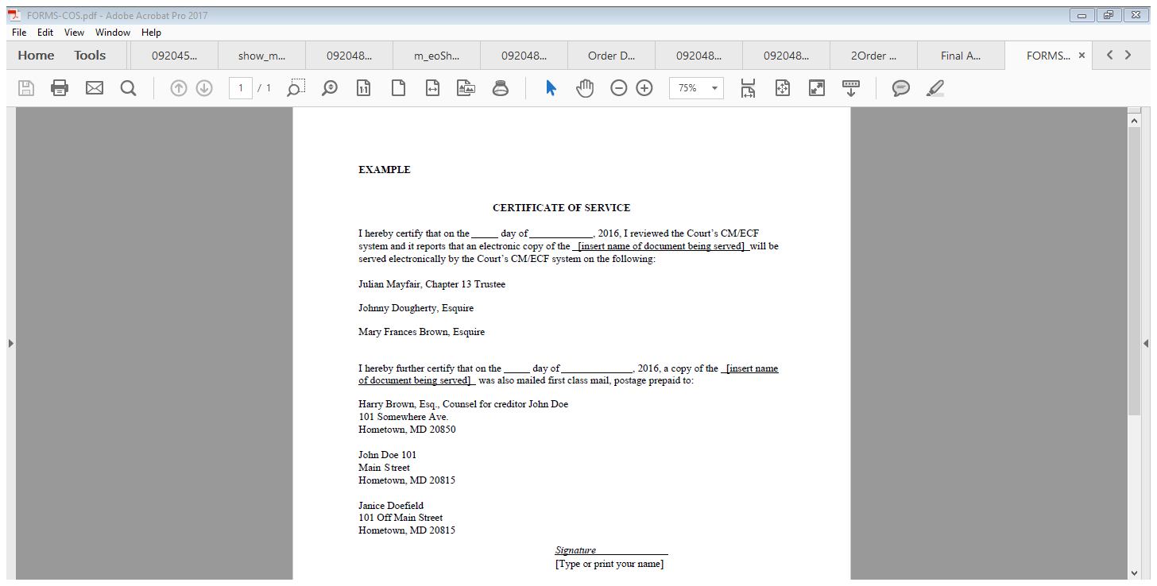

Slide 13

SERVICE ON THE STATE
Serve the State as directed by state law per Bankruptcy Rule 7004(b)(6):
State of Maryland – Serve the Attorney General OR serve an individual designated by the Attorney General in a writing filed with the Clerk of the Court of Appeals under Md. Rules 2-124(j) and 3-124(j).
State Officer or Agency – Serve the resident agent designated by the officer or agency OR serve the Attorney General OR serve an individual designated by the Attorney General in a writing filed with the Clerk of the Court of Appeals under Md. Rules 2-124(k) and 3-124(k).
Local Subdivision of the State (a county, municipal corporation, bicounty or multicounty agency, public authority, special taxing authority, etc.) – Serve the resident agent designated by the local entity OR, if there is no resident agent or a good faith effort to serve the resident agent has failed, serve the chief executive or presiding officer under Md. Rules 2-124(l) and 3-124(l).

Slide 14

AMENDING LISTS AND SCHEDULES
Local Bankruptcy Rule 1009-1 requires that, when filing amended schedules that add previously unscheduled creditors, a debtor must:
send a copy of the amended schedules to the Office of the United States Trustee and to any trustee appointed in the case;
send to each creditor added or whose status is changed by an amended schedule:
  a copy of the amended schedule;
  a copy of the original Notice for Meeting of Creditors; and
  a copy of each order that establishes or extends a bar date for filing proofs of claims or complaints to determine the dischargeability of certain debts or to object to the discharge of the debtor; and
file a certificate of compliance with this Rule, together with a dated and clearly titled SUPPLEMENTAL mailing matrix that lists only the names and correct mailing addresses of all newly scheduled creditors.

Slide 15

21-DAY NOTICES
Bankruptcy Rule 2002 and Local Bankruptcy Rule 2002-1 address:
Motion to assume/reject executory contract (see also Bankruptcy Rule 6006 and Local Bankruptcy Rule 6006)
Motion to sell, including free and clear sales (see also Bankruptcy Rule 6004 and Local Bankruptcy Rule 6004)
Motion to modify Chapter 13 plan
Application for compensation over $1,000 (see also Local Bankruptcy Rule 2070-1 for service in Chapter 11 cases)
Motion to abandon (non-trustee requests)
Motion to convert Chapter 7, 11, and 12 cases
Motion to convert Chapter 7 case to Chapter 13 case filed by debtors
Motion to convert Chapter 13 case filed by non-debtors
Motion to dismiss Chapter 13 case (notice and motion may be combined; see Local Bankruptcy Rule 9013-1)
Motion to dismiss Chapter 7, 11, and 12 (court issues the notice)

Slide 16

MOTIONS TO SHORTEN TIME
AND/OR FOR EXPEDITED HEARING
Local Bankruptcy Rule 9013-7 requires that:
Movant file contemporaneously with the motion (e.g., motion to sell or incur debt) a separate motion requesting that the court shorten the time within which responses may be filed and/or requesting that the Court set an expedited hearing; and
Movant include the following language in the notice: MOVANT HAS ALSO FILED A MOTION TO SHORTEN THE TIME FOR RESPONSE AND/OR FOR AN EXPEDITED HEARING. IF THAT MOTION TO SHORTEN OR EXPEDITE IS GRANTED, THE TIME TO OBJECT AND/OR DATE FOR HEARING WILL BE CHANGED AS PROVIDED IN SUCH ORDER.

Slide 17
MOTIONS TO AVOID LIENS
When filing a motion to avoid a lien:
Review Local Bankruptcy Rule 3012-1 (Section 506), Local Bankruptcy Rule 3012-2 (Section 506), and Local Bankruptcy Rule 4003-1 (Section 522);
When appropriate, use Local Forms C, G, H, and/or L;
Include 28-day notice and set hearing through CM/ECF 49+ days out;
Ensure certificate of service complies with Local Bankruptcy Rule 9013-4;
Serve respondents under Bankruptcy Rules 9014 and 7004;
Serve non-debtor owners under Bankruptcy Rule 7004; and
Serve respondents who have filed a proof of claim by also mailing motion and notice to name and address listed as receiving notice on proof of claim.

Slide 18

OBJECTIONS TO EXEMPTIONS
Local Bankruptcy Rule 4003-1 requires that objection contain conspicuous notice that:
any opposition to the objection must be filed and served within twenty-eight (28) days after the objection was served; and
the court may rule upon the objection and any response thereto without a hearing.

Slide 19
OBJECTIONS TO CLAIMS
When filing a claim objection:
Include notice language required under Local Bankruptcy Rule 3007-1:
within thirty (30) days after the date on the certificate of service of the objection, the claimant may file and serve a memorandum in opposition, together with any documents and other evidence the claimant wishes to attach in support of its claim, unless the claimant wishes to rely solely upon the proof of claim; and an interested party may request a hearing that will be held at the court’s discretion;
Serve the creditor the objection under Bankruptcy Rules 9014 and 7004; and
Serve the objection to the name and address where notices should be sent on the proof of claim by first class mail under Bankruptcy Rule 3007(a)(2).

Slide 20

DISMISSALS AND SETTLEMENTS
When dismissing an adversary proceeding:
Dismissal of adversary proceeding objecting to debtor’s discharge under Bankruptcy Rule 7041: requires notice to the trustee, the United States Trustee, and other persons the court may direct
Dismissal of other adversary proceedings under Rule 41 and Bankruptcy Rule 7041: requires notice of the plaintiff if there has not been a responsive pleading by the defendant OR a stipulation signed by all parties

Slide 21

DISMISSALS AND SETTLEMENTS
When settling or compromising a contested matter or adversary proceeding:
file a motion to approve and serve it on all parties to the adversary or contested matter if the settlement involves anything other than a withdrawal of the motion or dismissal of the complaint (e.g., a transfer of cash or other property to or from the debtor or bankruptcy estate) under Bankruptcy Rule 9019 and Local Bankruptcy Rule 9019-1; and
provide 21 days’ notice of a hearing on the settlement of an adversary proceeding to the debtor, the trustee and all creditors under Bankruptcy Rule 2002(a)(3).

Slide 22
CONSENT ORDERS
See Administrative Order 03-02, as amended December 2016, located in Appendix H of the Local Bankruptcy Rules.
Orders that are submitted other than with the pleading, such as consent orders and orders embodying a ruling, must be uploaded directly into the Court’s E-Orders system.
Consent orders must be circulated and signed conventionally. The original consent order bearing original signatures of the consenting parties must be maintained by the filing user until three (3) years after the bankruptcy case is closed.
The name (in the form appearing on the original) of each party executing the Stipulation or proposed Consent Order must be printed at the end of the text, preceded by /s/ to indicate an original signature.
Attorneys submitting proposed consent orders must include the following certification of consent:
I HEREBY CERTIFY that the terms of the copy of the consent order submitted to the Court are identical to those set forth in the original consent order; and the signatures represented by the /s/ on this copy reference the signatures of consenting parties on the original consent order.
TIP: If there are not at least THREE distinct signature lines, something is missing.

Slide 23
RULES YOU SHOULD KNOW
Bankruptcy Rule 2002(a) and (b) – 21-day notices and 28-day notices
Bankruptcy Rule 2002(c) – content of certain types of notices
Bankruptcy Rule 2002(g) – addressing notices
Bankruptcy Rule 2002(h) – notices to creditors whose claims are filed
Bankruptcy Rule 2002(j) – notices to the United States
Bankruptcy Rule 2002(k) – notices to the United States Trustee
Bankruptcy Rule 7004(b) – service by first class mail
Bankruptcy Rule 7004(e) – time limit for service of summons and complaint (7 days)
Bankruptcy Rule 7004(h) – service on insured depository institution by certified mail
Bankruptcy Rule 7041 – notices of dismissal of adversary objecting to discharge
Local Bankruptcy Rules 3012-1, 3012-2 and 4003-1 – notices of avoidance of liens
Local Bankruptcy Rule 6004-1 – notices of sales of estate property
Local Bankruptcy Rule 6006-1 – notices of assumption or rejection of contracts and leases
Local Bankruptcy Rules 7005-2 and 9013-4 – form of certificate of service
Local Bankruptcy Rule 9013-5 – responsibility for proper service

Slide 24
OTHER
COMMON ISSUES

Slide 25
MOTIONS FOR RECONSIDERATION
Bankruptcy Rule 9023
  makes Rule 59 applicable in bankruptcy cases
  14-day deadline from entry of judgment
Bankruptcy Rule 9024
  makes Rule 60 applicable in bankruptcy cases
  except that:
    motions to reopen and motions to reconsider (dis)allowance of claims not subject to one-year limitation in Rule 60(c)
    deadline to file complaints to revoke discharge in Chapter 7 governed by Section 727(e)
    deadline to file complaints to revoke confirmation order governed by Sections 1144, 1230, and 1330
Bankruptcy Rule 3008 governs reconsideration of allowance or disallowance of claims
Bankruptcy Rule 8008 may govern motion if appeal has been filed

Slide 26

MOTIONS FOR RECONSIDERATION
Grounds for relief under Rule 60(b):
(1) mistake, inadvertence, surprise, or excusable neglect;
(2) newly discovered evidence that, with reasonable diligence, could not have been discovered in time to move for a new trial under Rule 59(b);
(3) fraud (whether previously called intrinsic or extrinsic), misrepresentation, or misconduct by an opposing party;
(4) the judgment is void;
(5) the judgment has been satisfied, released, or discharged; it is based on an earlier judgment that has been reversed or vacated; or applying it prospectively is no longer equitable; or
(6) any other reason that justifies relief.

Slide 27

“[R]econsideration of a judgment after its entry is an extraordinary remedy which should be used sparingly.” Pacific Ins. Co. v. American Nat. Fire Ins. Co., 148 F.3d 396, 403 (4th 1998) (citation omitted).
MOTIONS FOR RECONSIDERATION

Slide 28

MOTIONS FOR RECONSIDERATION
Grounds for granting a motion to reconsider:
  “(1) to accommodate an intervening change in controlling law;”
  “(2) to account for new evidence not available at trial”; or
  “(3) to correct a clear error of law or prevent manifest injustice.”
  Pacific Ins. Co. v. American Nat. Fire Ins. Co., 148 F.3d 396 (4th Cir. 1998)

Slide 29

MOTIONS FOR RECONSIDERATION
“[R]un-of-the-mill inattentiveness by counsel is not ‘excusable neglect.’” Thompson v. E.I. DuPont de Nemours & Co., Inc., 76 F.3d 530, 535 (4th Cir. 1996).
“We find nothing extraordinary or unusual about counsel’s calendaring error that should relieve [Plaintiff] of its duty to comply with the time limit ...” Symbionics Inc. v. Ortlieb, 432 Fed. Appx. 216 (4th Cir. 2011) (unpublished).

Slide 30
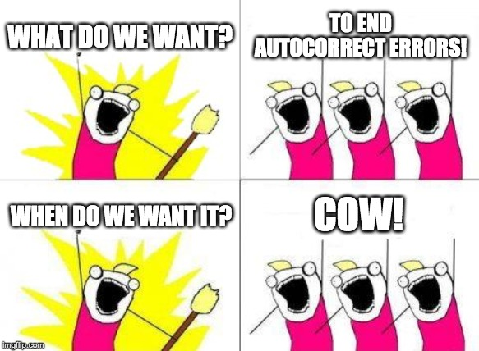
PROPOSED ORDERS
Before submitting a proposed order:
review for grammatical and spelling errors;
be explicit about the relief granted (do not just state that the motion is granted);
revise your forms to conform to orders entered by Court;
only refer to a hearing if one was held;
use proper caption (movant v. respondent) for lift stay orders; and
give careful consideration to cc list.

Slide 31

FEE APPLICATIONS
Before submitting your fee application:
check your math;
ensure application does not seek fees before employment authorized;
consider supplemental fee applications; and
consider motions for direct payment.

Slide 32

REAFFIRMATION AGREEMENTS
When filing a reaffirmation agreement:
file the agreement within 60 days of first date for 341 meeting as required by Bankruptcy Rule 4008;
explain any difference in income from Schedule I;
ensure that the form is complete (including the cover sheet); and
ensure that Statement of Intention states debtor will reaffirm debt if seeking an order under In re Chim, 381 B.R. 191 (Bankr. D. Md. 2008).

Slide 33

FIRST DAY MOTIONS
File appropriate first day motions in Chapter 11 cases:
Motion to Use Cash Collateral
  Section 363(a)
  Bankruptcy Rule 4001
Critical Vendor Motion
  Sections 363(b)(1) and 503(b)(9)
  In re Kmart Corp., 359 F.3d 866 (7th Cir. 2004)
Motion to Authorize DIP Financing
  Sections 364 and 1129(a)(9)(A)
  Bankruptcy Rule 4001

Slide 34

FIRST DAY MOTIONS
File appropriate first day motions in Chapter 11 cases (cont.):
Application to Employ Professionals
  Sections 327, 328, 1103, and 1107
  Bankruptcy Rule 2014
Motion to Pay Pre-Petition Wages
  Section 507(a)(4)
Motion to Continue Cash Management System and Maintain Existing Accounts
  Section 345
Motion to Extend Time to File Schedules and Statements
  Sections 521(i) and 1116(3)
  Bankruptcy Rule 1007(a)(5)

Slide 35

MOTIONS TO EXTEND TIME
When filing a motion to extend time:
File as soon as possible (i.e., well before deadline you want to extend);
Be specific as to the relief sought (i.e., requested date);
Be reasonable and try to request a new date that does not adversely impact other deadlines;
File early enough that opposing counsel has time to respond; and
Attempt to obtain consent of opposing party (it increases the odds of expeditious consideration and approval if requirements are met).

Slide 36

MOTIONS TO EXTEND TIME
Bankruptcy Rule 9006(b)(1) provides “the court for cause may at any time in its discretion” extend time:
for any reasons before the deadline has passed; and
only if there was excusable neglect after the deadline has passed.
Bankruptcy Rule 4003(b)(1) requires the movant make the request before the deadline and show cause.

Slide 37

MOTIONS TO EXTEND TIME
The Bankruptcy Rules limit the Court’s discretion to extend deadlines:
request to extend deadline to object to discharge must be made before the deadline per Bankruptcy Rule 4004(b)(1);
request to extend deadline to object to discharge may be made after the deadline only if there are new facts supporting revocation that were learned without time to timely object per Bankruptcy Rule 4004(b)(2); and
request to extend deadline to file complaint to determine dischargeability of debt must be made before deadline and must show cause per Bankruptcy Rule 4007(c).

Slide 38

AFFIDAVITS
Affidavits, generally:
use liberally when evidence is required to sustain burden; and
ensure proper form of attestation.
Affidavits in support of objections to claims:
proof of claim is prima facie evidence of validity and amount if properly filed (see Section 502 and Bankruptcy Rule 3001(f)); and
burden shifts to objecting party to rebut validity with evidence and creditor has ultimate burden of proving claim by preponderance of evidence (In re Harford Sands Inc., 372 F.3d 637, 640 (4th Cir. 2004)).

Slide 39

AFFIDAVITS
Affidavits in support of objections to exemptions under Bankruptcy Rule 4003:
“In any hearing under this rule, the objecting party has the burden of proving that the exemptions are not properly claimed. After hearing on notice, the court shall determine the issues presented by the objections.”
Affidavits in support of motions for default judgments under Rule 55 and Bankruptcy Rule 7055:
use to show failure to plead/defend;
use to show amount due; and
use to show individual is not in military (see Servicemembers Civil Relief Act, 50 U.S.C. §§ 3901-4043).

Slide 40

MOTIONS TO EXTEND STAY
When filing a motion to extend the automatic stay:
Be mindful of the 30-day statutory deadline under Section 362(c)(3)(B); and
File the motion with the petition!

Slide 41

RULE 2004 MOTIONS AND ORDERS
Bankruptcy Rule 2004:
Rule generally allows a fishing expedition but only with respect to “the acts, conduct, or property or to the liabilities and financial condition of the debtor, or to any matter which may affect the administration of the debtor's estate, or to the debtor's right to a discharge”;
Rule requires that motion specify basis for examination (cannot simply parrot language of the Rule);
Court’s form order provides extent of relief available; and
Court’s form order references “Document Request attached to the Motion for Examination” so remember to attach document requests to the motion if you want documents.

Slide 42
VIDEOCONFERENCE HEARINGS
Prior to a videoconference hearing:
consult the “Videoconference Hearing Protocol” on the Judge’s webpage (ex. https://www.mdb.uscourts.gov/judges-info/judge/maria-ellena-chavez-ruark);
discuss stipulations of facts and objections to exhibits with opposing counsel;
pre-file a witness list and an exhibit list (and attach copies of exhibits);
ensure that your client and witnesses know how to access the Zoom hearing, that they understand they should be in a quiet and safe place for the hearing (ex. not driving), and that they know to mute their audio when not speaking; and
ensure your witnesses have copies of all potential hearing exhibits.

Slide 43

VIDEOCONFERENCE HEARINGS
During a videoconference hearing:
log in for the hearing at least 10-15 minutes prior to the start time to ensure your audio and video are working properly;
ensure your witnesses’ audio and video are working properly so Court can see and hear them and appropriately evaluate their credibility;
mute your audio when you are not speaking; and
participate in the hearing the same as you would if the hearing were in person (ex. dress appropriately, do not directly address other hearing participants, give full attention to the Court, etc.).

Slide 44
THANK YOU
FOR LISTENING!
Panelists
Vivian P. Diokno
Kerry Hopkins
Jacob G. Masters
Marios J. Monopolis
Moderator
The Honorable Maria Ellena Chavez-Ruark

